Slide 1

Cloud Deployment Models (Public, Private, Hybrid)
Introduction to Cloud Computing

Slide 2
Lecture Objectives
Understand the definition and types of cloud deployment models.
Learn about public, private, and hybrid clouds.
Explore use cases for each deployment model.
Discuss transitioning between deployment models.

Slide 3
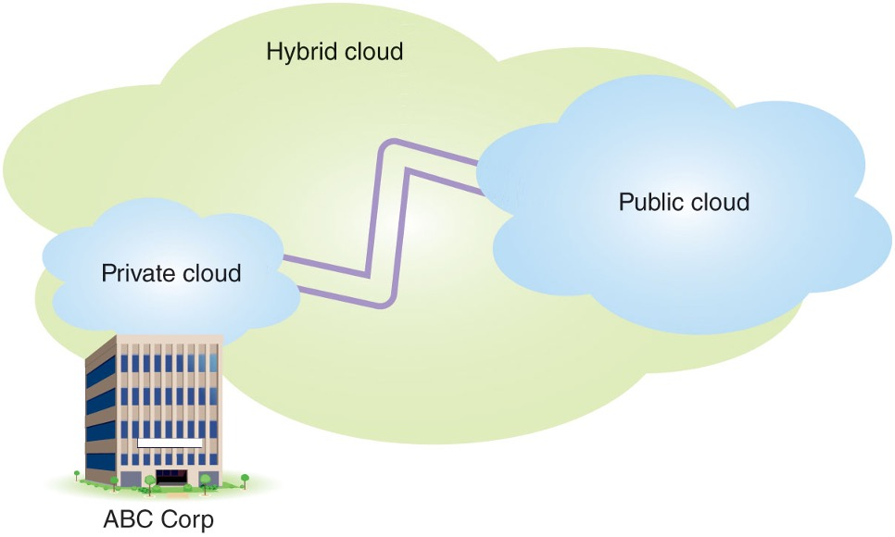
Overview of Deployment Models
Public Cloud: Services offered over the internet by providers like AWS, Azure, or Google Cloud.
Private Cloud: A dedicated environment for a single organization, offering greater control and security.
Hybrid Cloud: A combination of public and private clouds, allowing for greater flexibility.

Slide 4
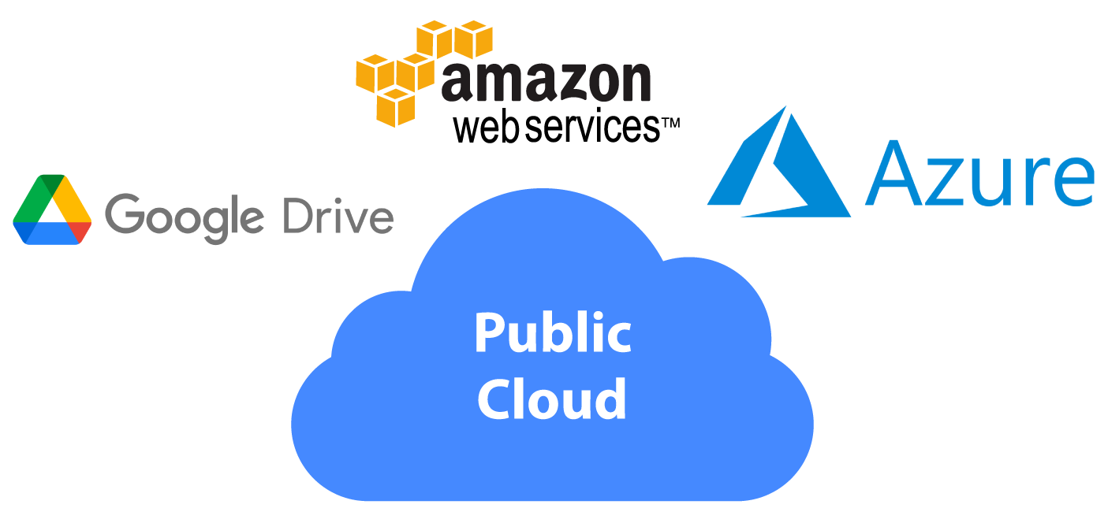
Public Cloud
Definition: Resources and services are shared and delivered over the internet.
Examples: AWS, Azure, Google Cloud.
Benefits:
Cost-effective for small to medium-sized businesses.
Highly scalable and flexible.
No maintenance required by the customer.

Slide 5
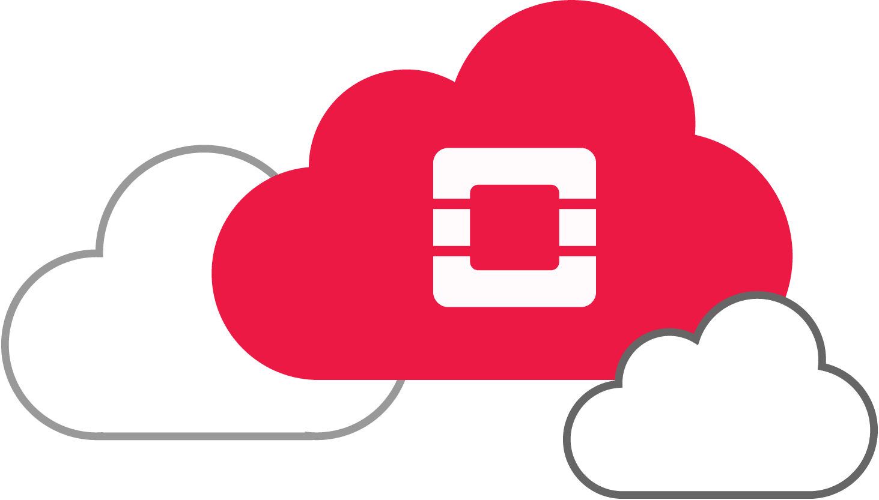
Private Cloud
Definition: Infrastructure dedicated exclusively to one organization.
Examples: VMware, OpenStack.
Benefits:
Enhanced security and control.
Customizable to specific organizational needs.
Suitable for compliance and regulatory requirements.

Slide 6
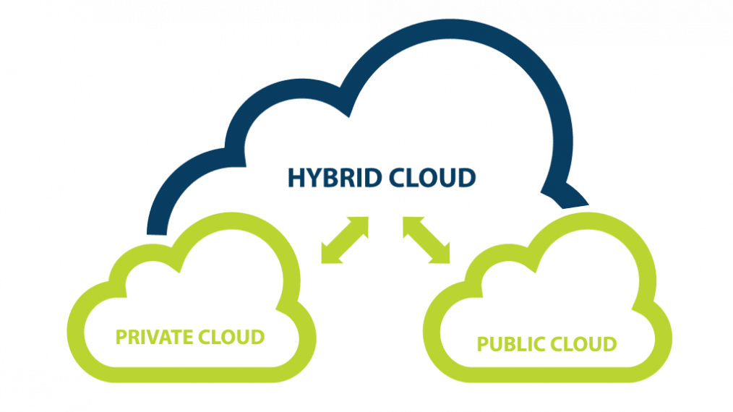
Hybrid Cloud
Definition: Combines public and private clouds to meet diverse needs.
Examples: Azure Stack, AWS Outposts.
Benefits:
Flexibility to scale resources as needed.
Balances security with scalability.
Ideal for variable workloads and disaster recovery.

Slide 7
Comparison of Deployment Models
Feature | Public Cloud | Private Cloud | Hybrid Cloud
Cost | Lower upfront cost | Higher upfront cost | Mix of public and private
Security | Moderate | High | Configurable
Scalability | High | Moderate | High
Management | Provider managed | Customer managed | Shared responsibility

Slide 8
Use Cases for Deployment Models
Public Cloud:
Ideal for startups and small businesses.
Used for testing and development environments.
Private Cloud:
Preferred by government agencies and financial institutions.
Organizations with strict compliance needs.
Hybrid Cloud:
Suitable for enterprises with seasonal demand spikes.
Often used for disaster recovery solutions.

Slide 9
Transitioning Between Models
Reasons for Transition:
Cost optimization.
Scaling resources efficiently.
Enhancing security or compliance.
Strategies:
Gradual migration using hybrid models.
Assessing workloads for suitability.
Utilizing tools like cloud migration services.

Slide 10
Summary
Public Cloud: Cost-effective and scalable.
Private Cloud: Secure and customizable.
Hybrid Cloud: Combines security with flexibility.
Use cases depend on organizational needs and workloads.

Slide 11
Questions?

